Slide 1

PIC16F877A Input/output Configuration

Slide 2
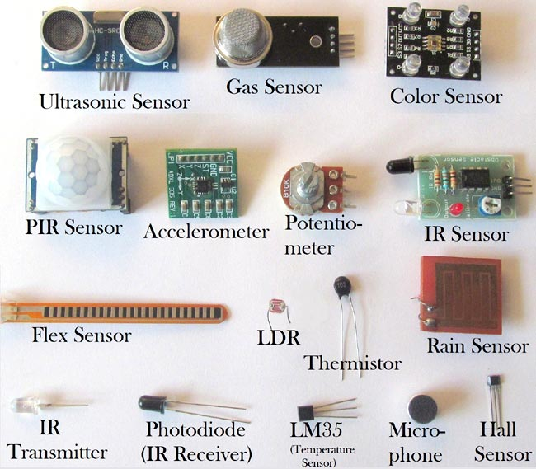
Input devices

Slide 3
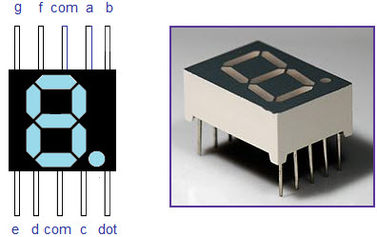
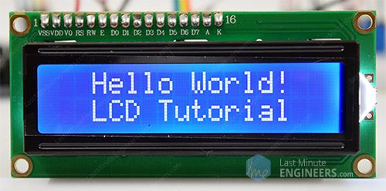
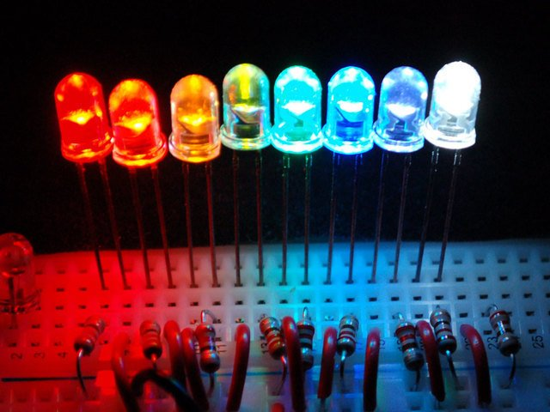
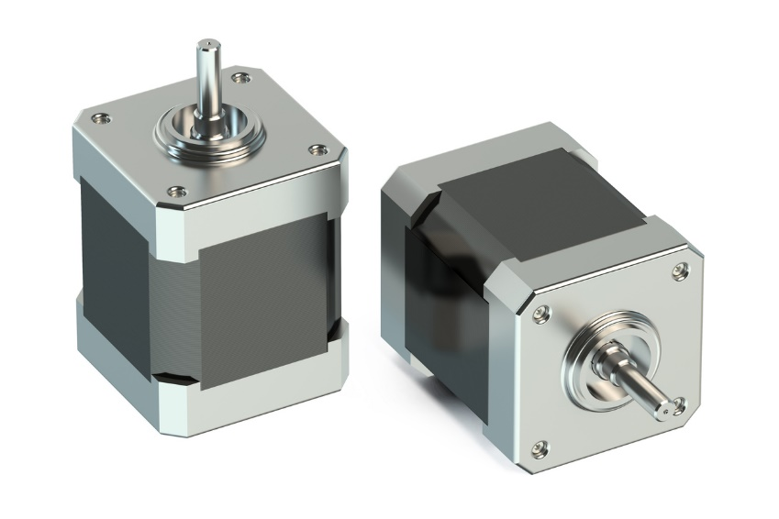
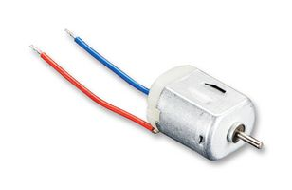
Output Devices
contenst

Slide 4
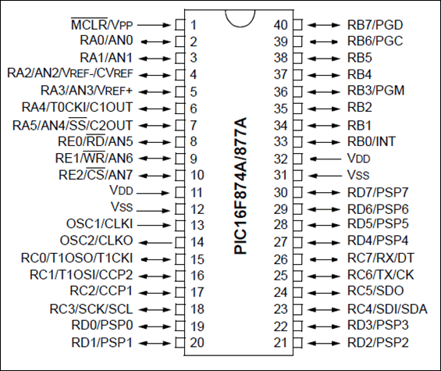
General Purpose Input Output
A GPIO (general-purpose input/output) port handles both incoming and outgoing digital signals. As an input port, it can be used to communicate to the CPU the ON/OFF signals received from switches, or the digital readings received from sensors.

Slide 5
I/O Ports
PIC16F877A has 5 GPIO ports ,these ports are named as A,B,C,D,E
Port A has 5 input/output pins
Port B has 8 input/output pins
Port C has 8 input/output pins
Port D has 8 input/output pins
Port E has 3 input/output pins
TRISx – Register is Used for Configure the port as Input or Output
x = A,B,C,D,E
PORTx – Register is used for ON/OFF the I/O ports
x = A,B,C,D,E

Slide 6
Input configuration & It’s Types
TRISA = 0b0000 0001; //Port A0 configured as input
TRISA = 0x01; //Port A0 configured as input
TRISA = (1<<0); // Port A0 configured as input
TRISA0 = 1; // Port A0 configured as input
Output configuration & It’s Types
TRISB = 0b0000 0000; //Port A0 configured as output
TRISA = 0x00; //Port A0 configured as output
TRISA = (0<<0): // Port A0 configured as output
TRISA0= 0; // Port A0 configured as output

Slide 7
Turn ON the I/O Ports
PORTA = 0b00000001; // Turn ON the Port A0
PORTA = 0x01; // Turn ON the Port A0
PORTA = (1<<0); //Turn ON the Port A0
RB0 = 1; //Turn ON the Port A0
Turn OFF the I/O Ports
PORTA = 0b00000000; // Turn OFF the Port A0
PORTA = 0x00; // Turn OFF the Port A0
PORTA = (0<<1); //Turn OFF the Port A0
RB0 = 0; //Turn OFF the Port A0

Slide 8
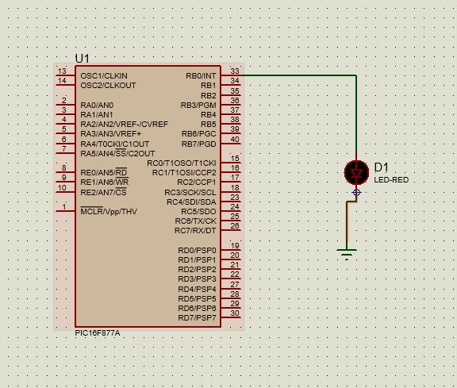
LED interfacing with PIC16F877A

Slide 9
Program for LED blink
#include<pic.h>
#define _XTAL_FREQ 4000000
void main()
{
TRISB = 0x00; //output
PORTB = 0x00; //off
while(1)
{
PORTB = ~ PORTB;
__delay_ms(1000);
}
}

Slide 10
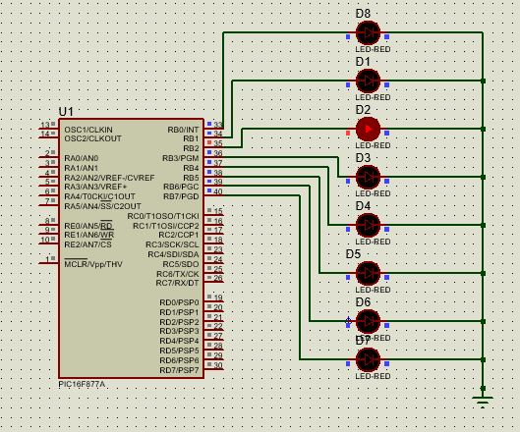
Even Led Blink

Slide 11
Program For Even Led Blink
#include<pic.h>
void delay()
{
unsigned int delay;
for(delay=0;delay<20000;delay++);
}
void main()
{
int a = 0;
TRISB = 0x00;
PORTB = 0xFF;
for(a=0;a<=7;a++)
{
if(!(a&1))
{
PORTB=(1<<a);
delay();
}
}
}

Slide 12
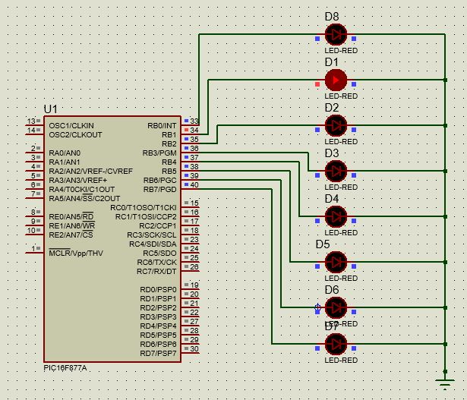
ODD Led Print

Slide 13
Program for Print Odd Led
#include<pic.h>
void delay()
{
unsigned int delay;
for(delay=0;delay<20000;delay++);
}
void main()
{
int a=0;
TRISB = 0x00;
PORTB = 0xFF;
for(a=0;a<=7;a++)
{
if (a&1)
{
PORTB=(1<<a);
delay();
}
}
}

Slide 14
8 4 2 1
0 0 0 0 ---------0
0 0 0 1 --------1
0 0 1 0 ---------2
0 0 1 1 ---------3
0 1 0 0 ---------4
0 1 0 1 ---------5
0 0 1 1 ---------3
0 0 0 0 0 0 0 1
0x01

